Slide 1

FFT and Integer Multiplication

Slide 2
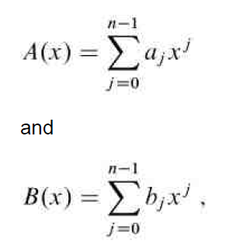
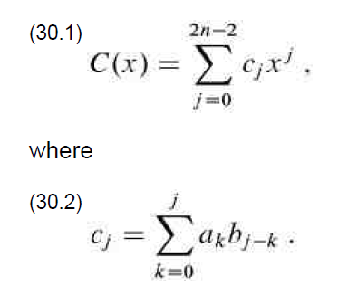
Motivation
Every integer can be represented as a polynomial
Simple multiplication of polynomials (and integers) of degree n takes O(n^2) time
We can do better!

Slide 3
Coefficient Representation
Allows for O(n) evaluation using Horner’s method:
A(x0) = a0 + x0(a1+ x0(a2 + … + x0(an-1))…)
Addition is O(n) as well
cj = aj + bj for j=0…n-1
Multiplication is more expensive
Each coefficient must be multiplied by every other, O(n^2)

Slide 4
Point-Value Representation
A(x) = {(x0,y0), (x1,y1), …, (xn-1, yn-1)}
such that:
All x are distinct
yk = A(xk) for k=0,1,…,n-1
Conversion from coefficient form to point-value is inexpensive
Choose n points x0,x1,…xn-1 then evaluate at A(xk) for k=0,1,…,n-1
With Horner’s method, evaluation takes O(n^2)

Slide 5
Perks of Point-Value Representation
***Effective choice of points xk allows for computation in O(n logn)***
Inverse of evaluation, interpolation, always yields a unique polynomial
Can be done in O(n^2) time using Lagrane’s formula
Addition is still O(n):
ck = ak + bk
Multiplication is now O(n)*:
ck = ak * bk

Slide 6
How to Choose Effective Points
Take advantage of symmetries in functions
For degree n:
When n is even, A(x) = A(-x)
When n is odd, A(x) = -A(-x)
Can split polynomial into even and odd terms
A(x) = Ae(x) = xAo(x)
By expanding into the complex domain, both facts remain true for recursive definitions of A(x)
Nth roots of unity fulfill both criteria! wn = e^(2ipi/n)

Slide 7
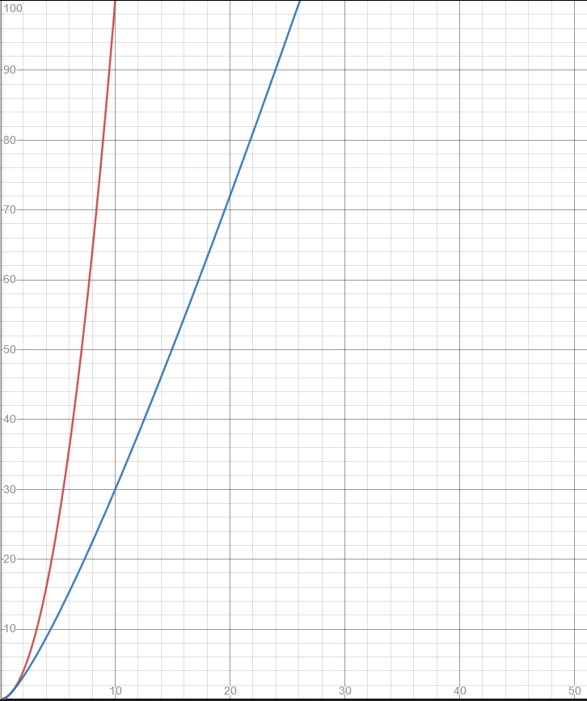
Putting It All Together
Convert from coefficient form to point-value form (using complex nth roots of unity)
Perform pointwise multiplication
Convert back to coefficient form
Red:
Ordinary Multiplication O(n^2)
Blue:
Efficient Multiplication O(n + 2n log n)

